Slide 1
Cyclistic! From Casual to Annual Membership
Aarav De
Aarav.de.ek26@gmail.com
(929) 375 7121

Slide 2
How do annual members and casual riders use cyclistic bikes differently?
Can our Annual Membership rise?

Slide 3
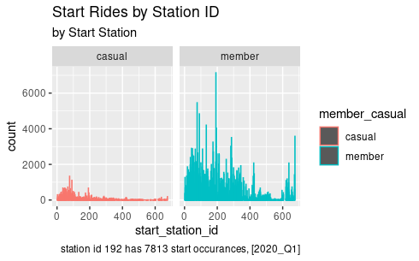
Data that matters
There are more instances of casual members using DIVVY at stations 0-200 than there are at stations 200-600. We should target these stations first.

Slide 4
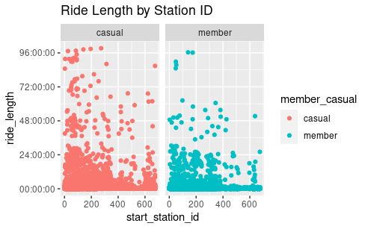
More longer trips as Casual Riders
Casual riders tend to use the bicycles longer

Slide 5
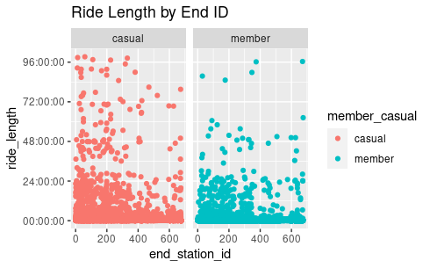
There are less day’s where bicycles are being rented than casual members by Annual Members

Slide 6
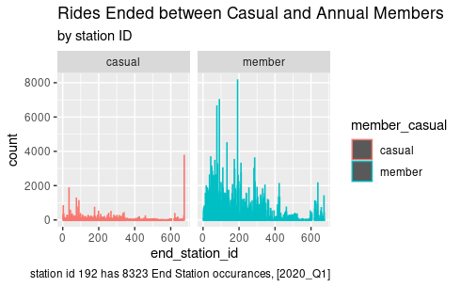
Rides Ended between Casual and Annual Members
Overall there are more rides ended and started by Annual Members than there are casual however, end station id’s from 1-200 have the highest concentration of users

Slide 7
How do annual and casual riders use their membership differently?
Annual rider’s use their bicycles more frequently and for shorter amounts of time

